Slide 1
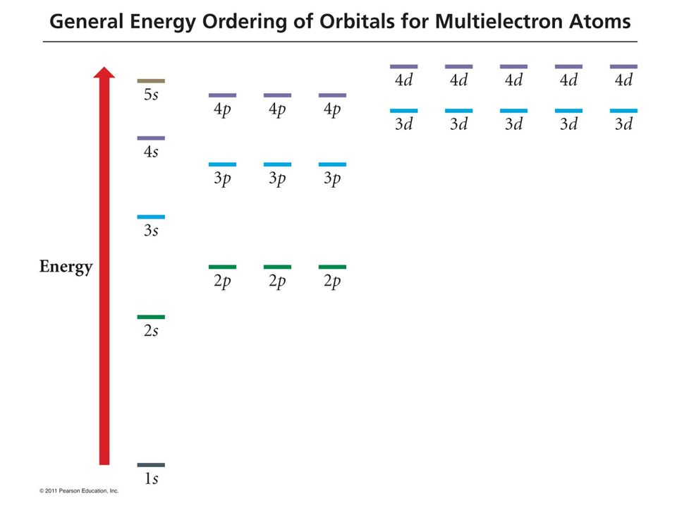
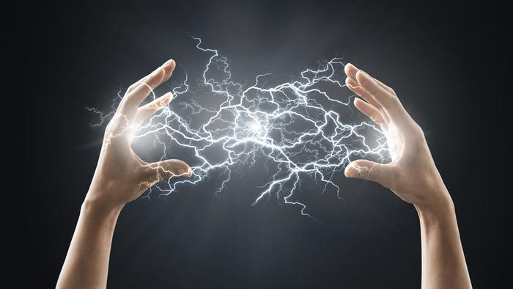
How do molecules emit light?
Step 1: Excitation
In this example, the starting electron configuration is 1s², but after application of the excitation (electricity, flame), the configuration is 1s¹3p¹

Slide 2
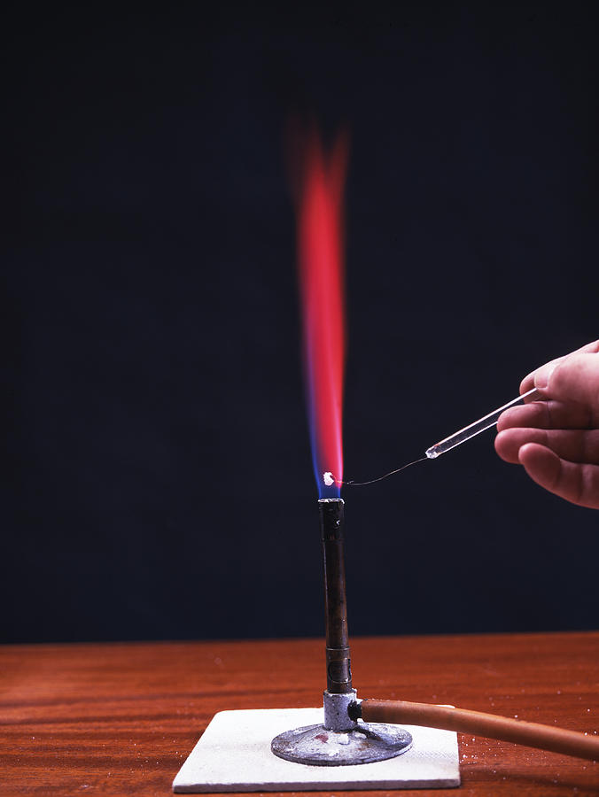
How do molecules emit light?
Step 2: Relaxation and emission
From the excited configuration 1s¹3p¹, the electron drops to a slightly lower energy configuration, 1s¹3s¹. The drop causes a spark of light (photon) to be emitted

Slide 3
How do molecules emit light?
Step 2: Relaxation and emission
From the excited configuration 1s¹3p¹, the electron drops to a slightly lower energy configuration, 1s¹3s¹. The drop causes a spark of light (photon) to be emitted
A key point is that the energy lost by the atom becomes the energy of the photon.

Slide 4
How do molecules emit light?
Each drop causes another spark of light (photon) to be emitted

Slide 5
What about the color of the light?
Two low-energy photons are emitted
One high-energy photon is emitted

Slide 6
What about the color of the light?
Two low-energy photons are emitted
The energy of the photon emitted is related to the color of the light!
One high-energy photon is emitted

Slide 7
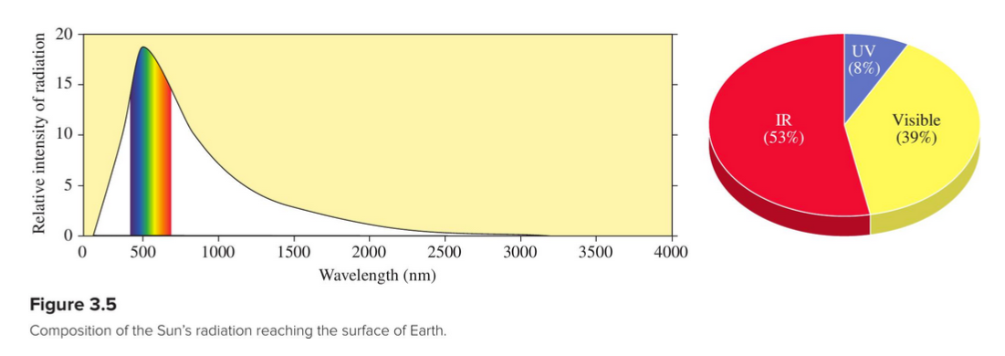
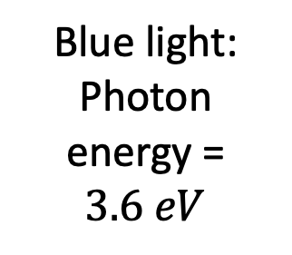
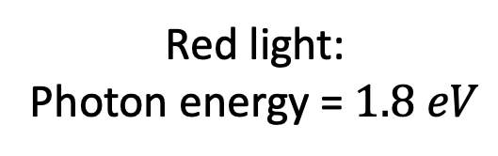
The 1.8-3.6 eV rule
Blue light:
Photon energy = $3.6 eV$
Red light:
Photon energy = $1.8 eV$
This type of graph is called an emission spectrum

Slide 8
The 1.8-3.6 eV rule
Blue light:
Photon energy = $3.6 eV$
Red light:
Photon energy = $1.8 eV$
This type of graph is called an emission spectrum

Slide 9
The 1.8-3.6 eV rule
Blue light:
Photon energy = $3.6 eV$
Red light:
Photon energy = $1.8 eV$
This type of graph is called an emission spectrum

Slide 10
The 1.8-3.6 eV rule
Blue light:
Photon energy = $3.6 eV$
Red light:
Photon energy = $1.8 eV$
This type of graph is called an emission spectrum

Slide 11
What about the color of the light?
Two low-energy photons are emitted
The energy of the photon equals the energy lost by the atom. For Helium, for example … (go to Spartan!)
One high-energy photon is emitted

Slide 12
What about the color of the light?
Energy lost = …

Slide 13
What about the color of the light?
Energy lost = 33 eV – (– 20 eV) = 53 eV …

Slide 14
What about the color of the light?
Energy lost = 33 eV – (– 20 eV) = 53 eV … so that’s also the photon energy
Photon energy-color rule
Photons with energy < 1.8 eV are invisible (may be IR)
Photons with energy between 1.8 and 3.6 eV are visible!
Photons with energy > 3.6 eV are invisible (may be uv)

Slide 15
What about the color of the light?
53 eV => this transition produces a photon that is not visible
Photon energy-color rule
Photons with energy < 1.8 eV are invisible (may be IR)
Photons with energy between 1.8 and 3.6 eV are visible!
Photons with energy > 3.6 eV are invisible (may be uv)

Slide 16
What about the color of the light?
These transitions are more likely to produce a visible photon
53 eV => this transition produces a photon that is not visible
Photon energy-color rule
Photons with energy < 1.8 eV are invisible (may be IR)
Photons with energy between 1.8 and 3.6 eV are visible!
Photons with energy > 3.6 eV are invisible (may be uv)

Slide 17
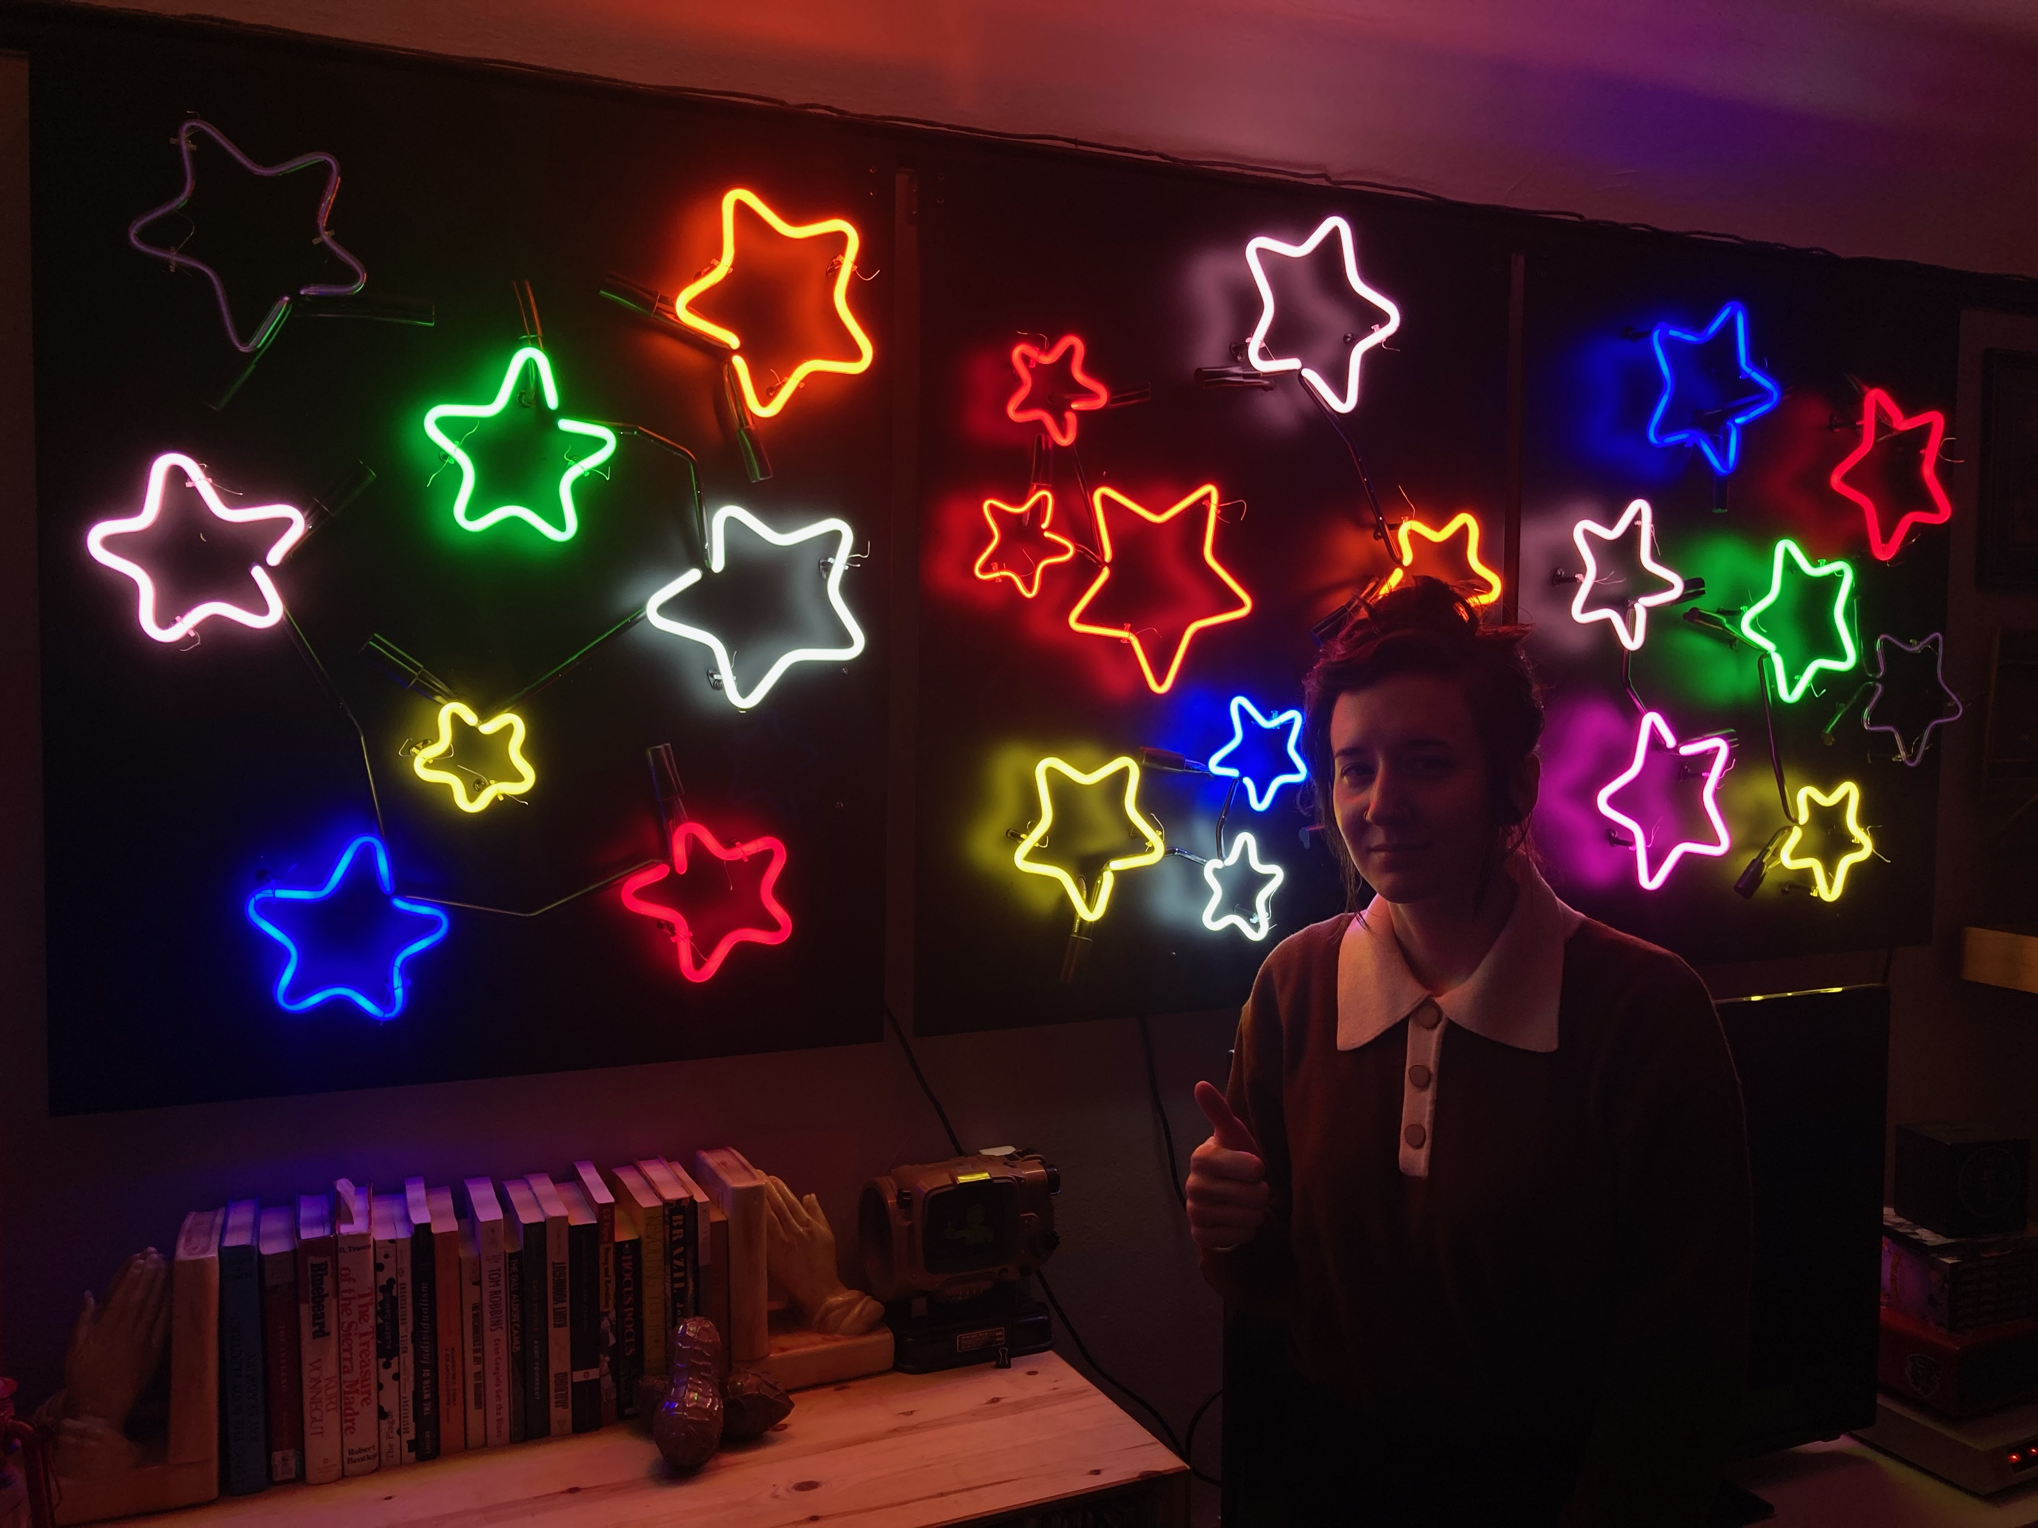
Geißler's gas discharge tubes
Zapping with electricity excites an electron
Subsequent relaxation emits a photon

Slide 18
Argon
Ground state Argon:
[Ar] = [Ne] 3s²3p⁶

Slide 19
Argon
Gets excited

Slide 20
Argon
Excited-state Argon:
[Ar] = [Ne] 3s²3p⁵4p¹

Slide 21
Argon
Relaxes to
[Ar] = [Ne] 3s²3p⁵4s¹

Slide 22
Argon
Relaxes to
[Ar] = [Ne] 3s²3p⁵4s¹

Slide 23
Argon
Is the photon visible?

Slide 24
Argon
What does Spartan say?
What’s the energy of the LUMO?
What’s the energy of the LUMO+1?
What’s the gap?
Is the resulting photon visible?

Slide 25
Argon
Spartan says:
LUMO+1 energy =+16.8 eV
LUMO energy = +13.7 eV
Gap = 16.8 – 13.7 eV = 3.1 eV
Gap is between 1.8 & 3.6 eV
=> Visible photon!

Slide 26
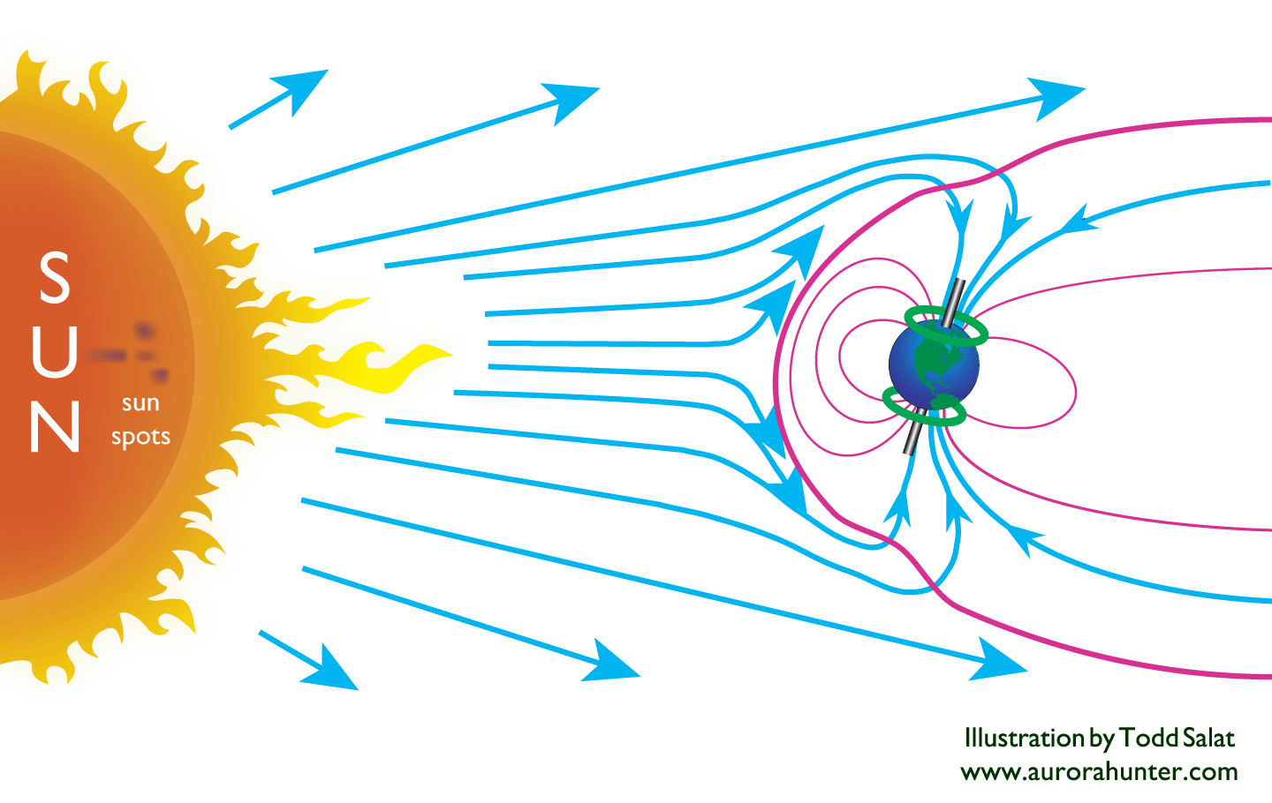
Aurora
The Aurora
High-energy solar particles excite electrons on oxygen and nitrogen atoms.
Subsequent relaxation causes photons to be emitted (green, red).

Slide 27
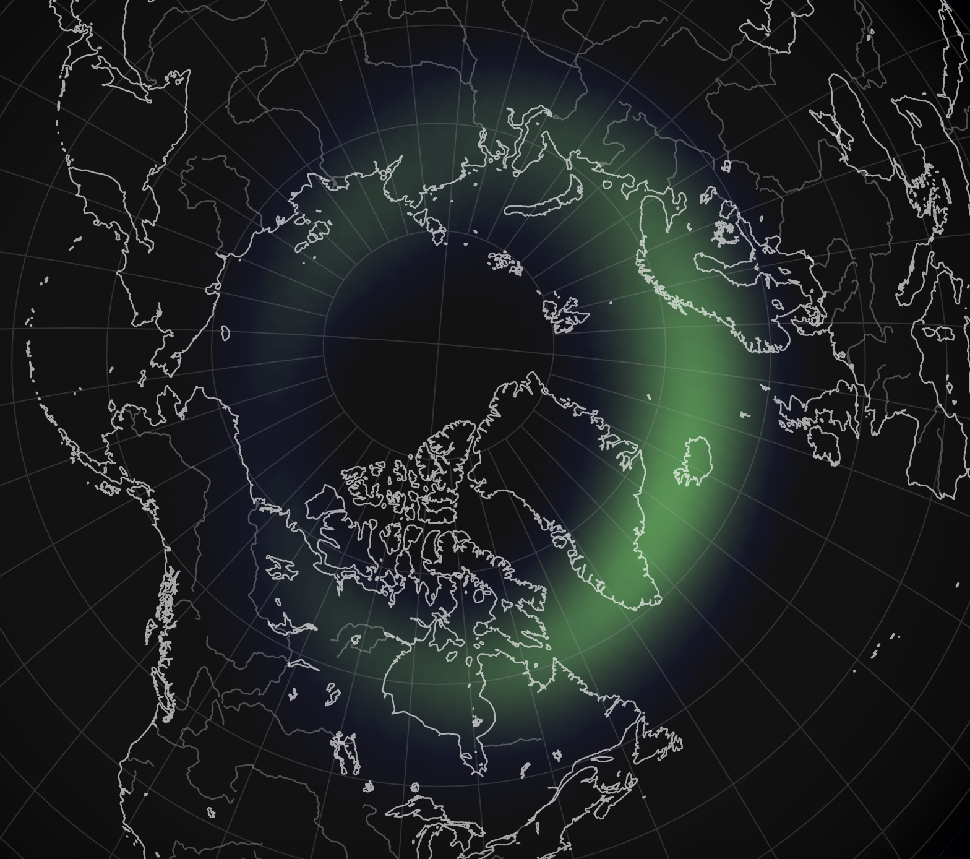
Aurora
The Aurora
High-energy solar particles excite electrons on oxygen and nitrogen atoms.
Subsequent relaxation causes photons to be emitted (green, red).

